Slide 1
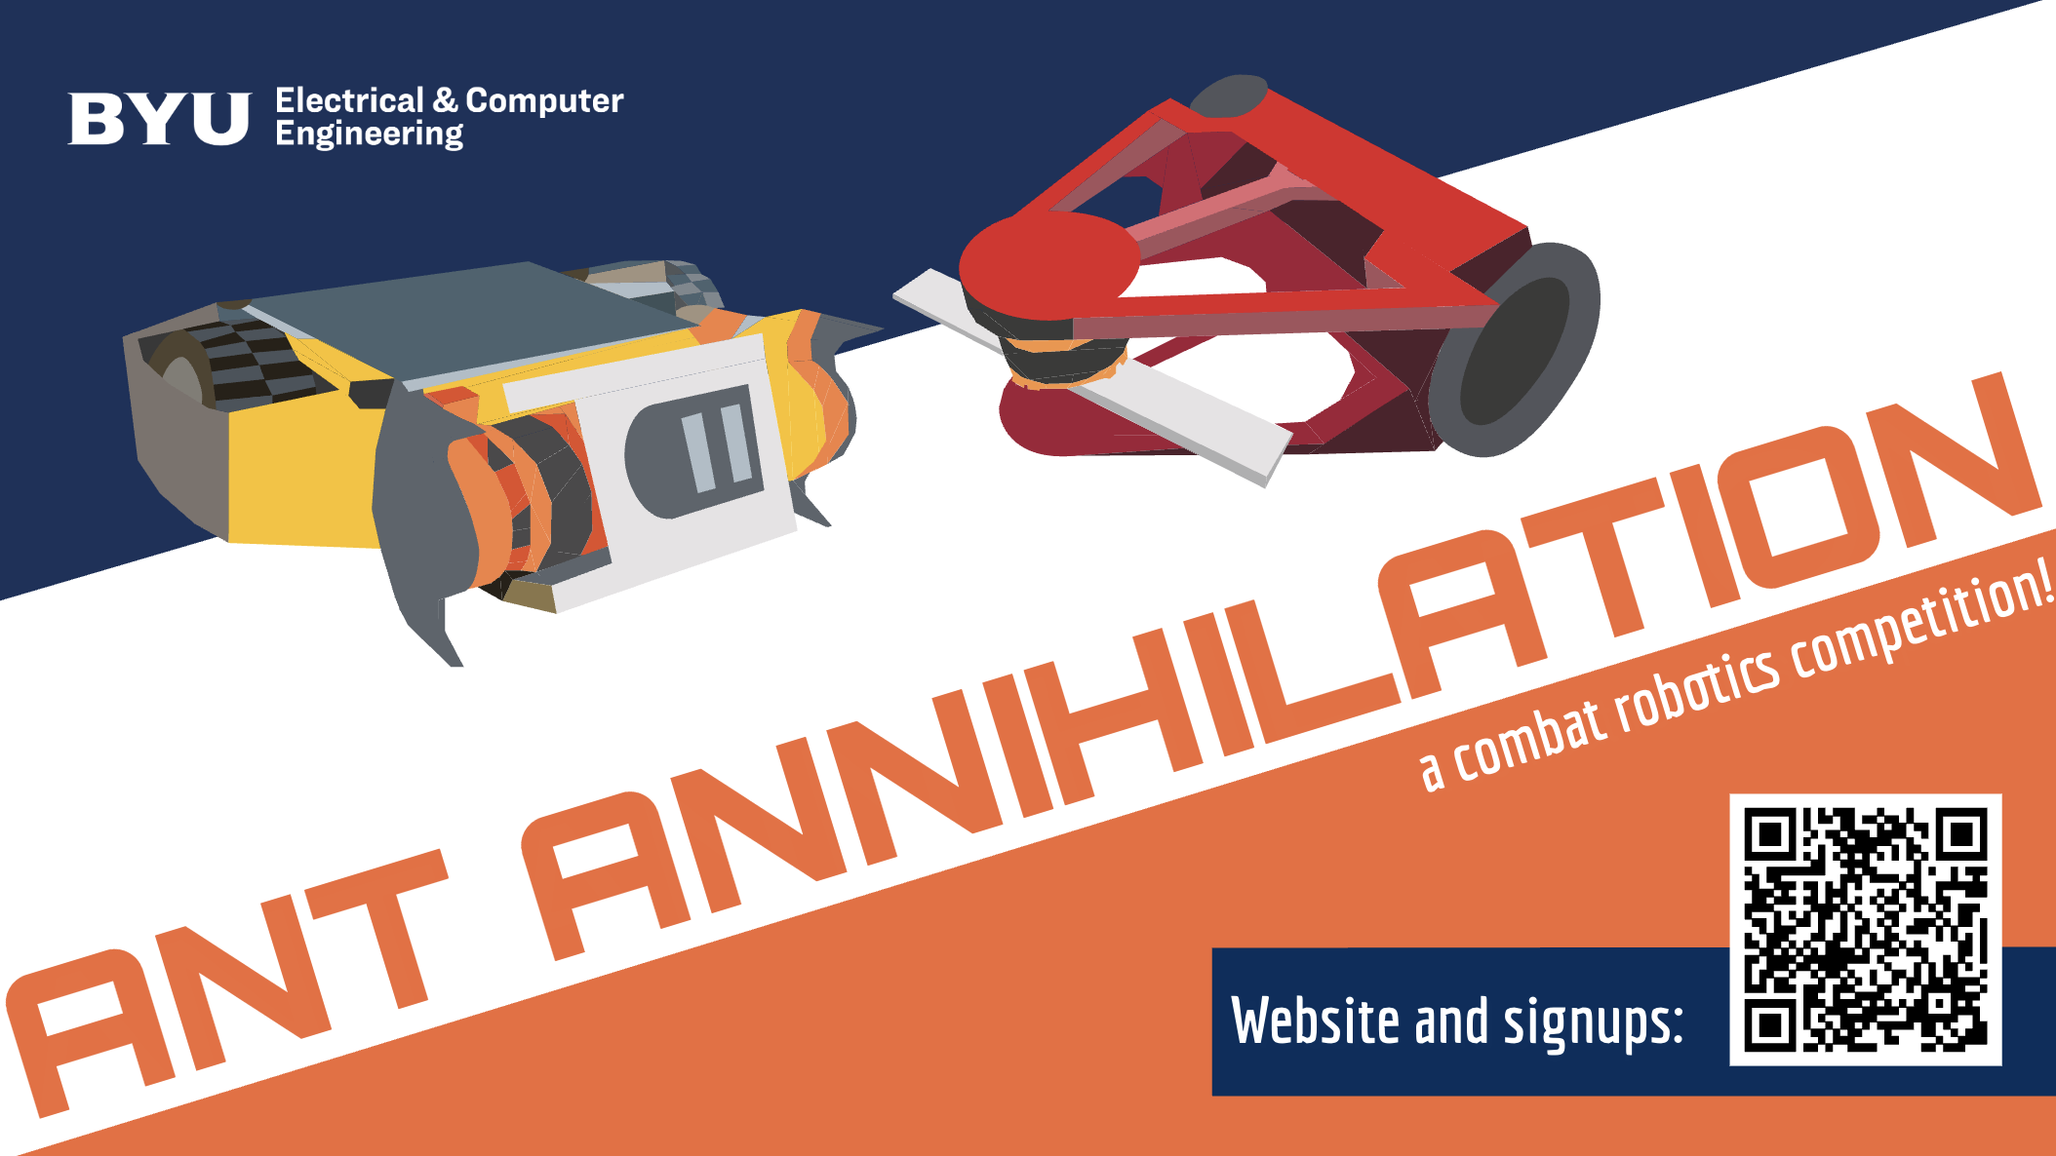

Slide 2
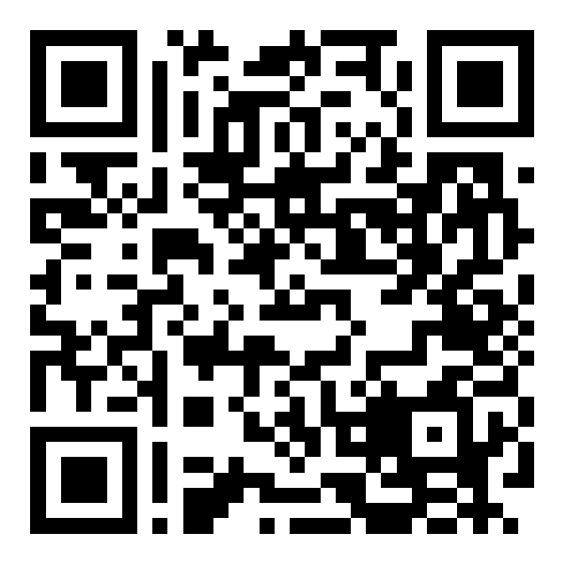
Signups:
Scan Here for the Qualtrics Signup Form!

Slide 3

Build Nights:
Thursdays, 6-8pm in 413 CB with…
and ECEn Shop Techs!

Slide 4

Save the Date(s)
Thursday 9/14, 6-8pm, Kickoff in EB Event Space (you made it!)
Saturday 10/14 Student Signups Close
Saturday 10/28 Alumni Signups Close
Thursday 11/2 , 6-8pm, Mid-Semester Review in EB Event Space
Thursday 11/16 , 6-8pm, Safety Inspections in 413 CB*
Saturday 12/2, 10am-3pm Ant Annihilation in the WSC Garden Court*
*Attendance Required

Slide 5
Some Important Rules:
Bots must fit in a 1ft cube at the start of the match
Armor and weapons must be made of PET, PETG, ABS, PLA, PLA+, etc.
Wheeled Robots must weigh 1lb or less
Matches will end after 3 min. or after Knock Out/Tap Out/Forfeit
There will be a separate bracket for alumni bots (given enough alumni compete)
Winners of both brackets will receive a trophy
Winners of the student brackets will receive cash prizes
Build your robot according to construction specifications. Loophole finding will NOT be rewarded.
Judges will choose a winner based on control, aggression, and damage
Unsportsmanlike conduct will not be tolerated

Slide 6
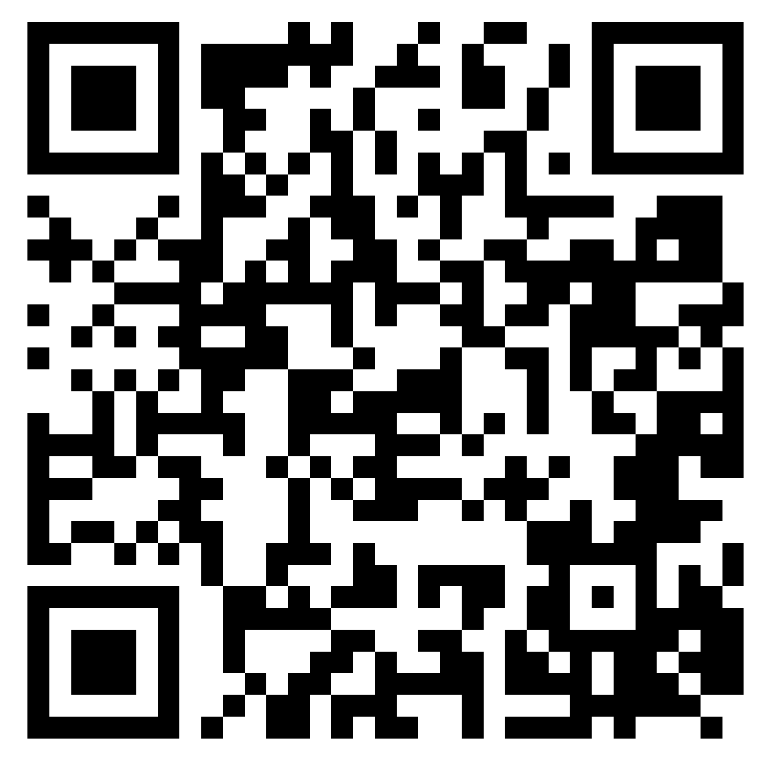
ARC Website:
Scan Here for Rules, Updates, tips, tricks, and MORE!

Slide 7
Purchases:
Can be made in person from the ECEn shop or through a Qualtrics survey for online orders
One week after signing up you’ll receive a link to the purchasing Qualtrics and can start making purchases
If you are a BYU student, use this address:
You will only be allowed to use up to $100 on your budget. The remaining amount CANNOT be used to partially pay for a purchase (like a gift card)
You need a good reason to buy whatever it is (no kitchen appliances)

Slide 8
Q&A:

